Slide 1
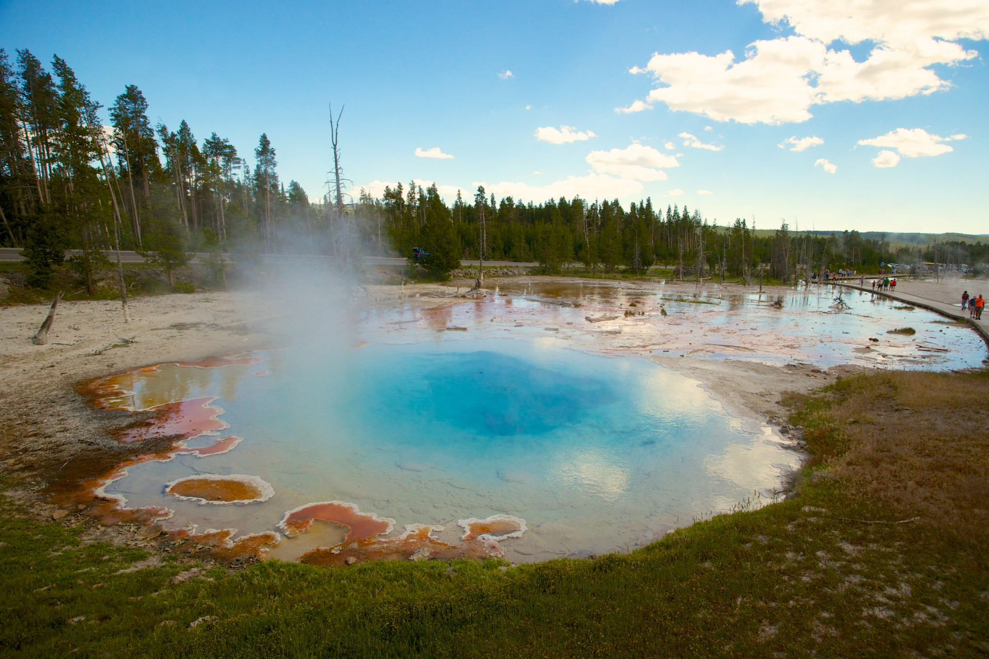





Microbes Living Together: Impacts of Trace Metals on Communities
Simon Fronmueller
Mentors/Advisors: Kate Weeks and Dr. Everett Shock
ASU School of Earth and Space Exploration
AZ Space Grant Symposium
April 18-19, 2025

Slide 2
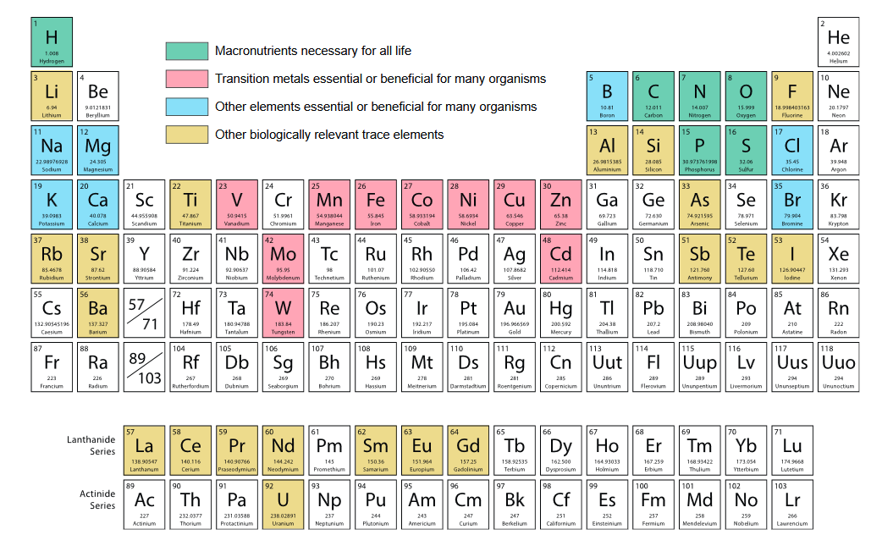

Metallome: The Metals of Life
Metals are essential for life
~⅓ of known proteins & ~½ of known enzymes
Some are toxic
Impacts on individual species well studied
Image credit: Rico et al., 2024

Slide 3
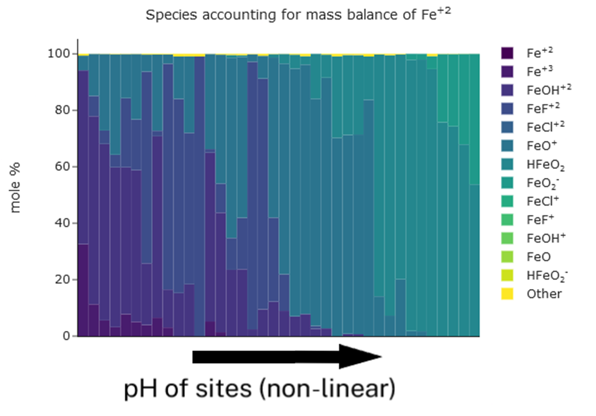
Speciation and Bioavailability
Not all forms of a metal can be used
Free ions usually better
Some microbes can “scavenge” otherwise unusable forms

Slide 4
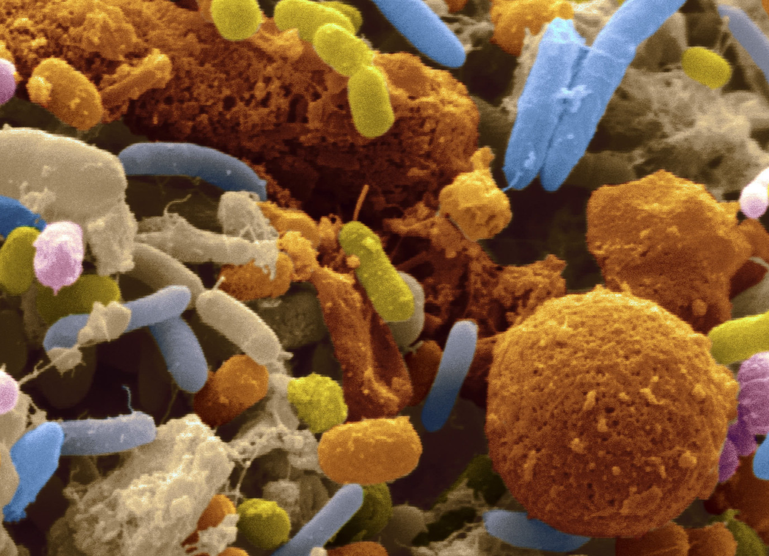
Mutualism and Un-culturability
Vast majority of microbes depend on other species to survive
Impact on one species *could* affect the whole community
Proposed explanation for the 99% unculturable problem
Image Credit: Science Magazine

Slide 5


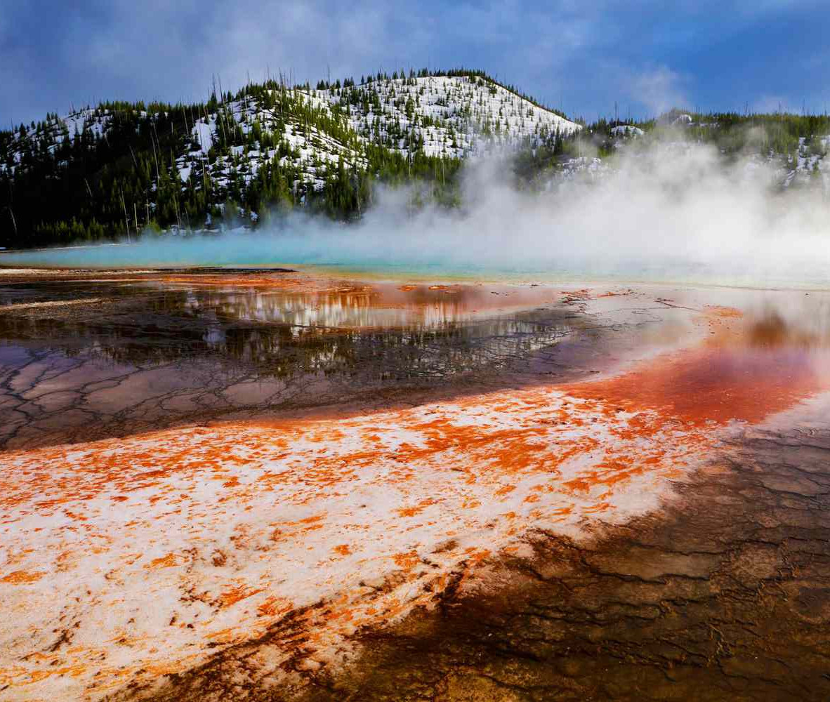

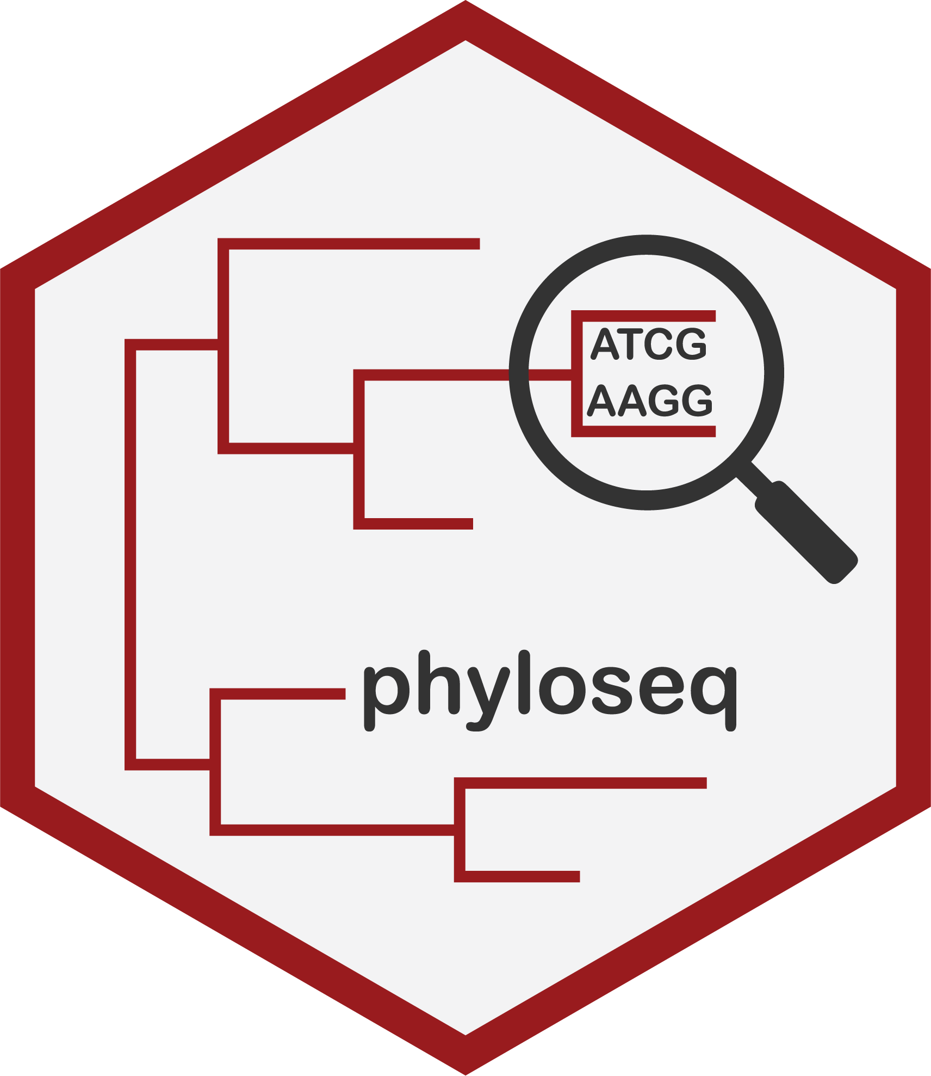

Sample Collection & Processing
60 Yellowstone National Park Hot Spring Sites
Quality control
Data Processing
Data Analysis & Graph Making
16S rRNA samples
Geochemical Samples
Image Credit: AGU
ICP-MS Measurement
Data Processing

Slide 6
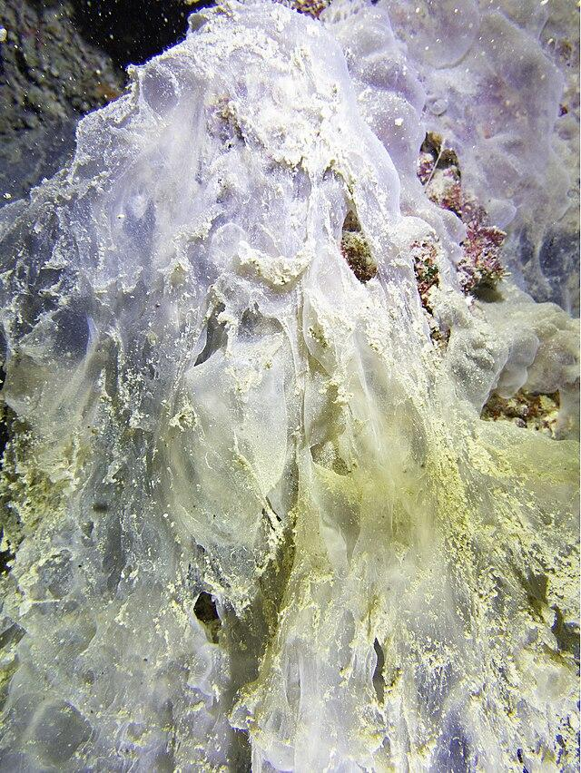
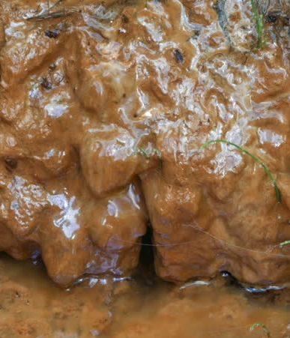
Arsenic: Sulfur Reducers (SRB) and Iron Reducers (DIRB)
Studies show SRB and DIRB, when together, can raise arsenic levels in groundwater
Does this hold true for Yellowstone springs?
How does it affect the community?
Image Credit: Wikipedia

Slide 7
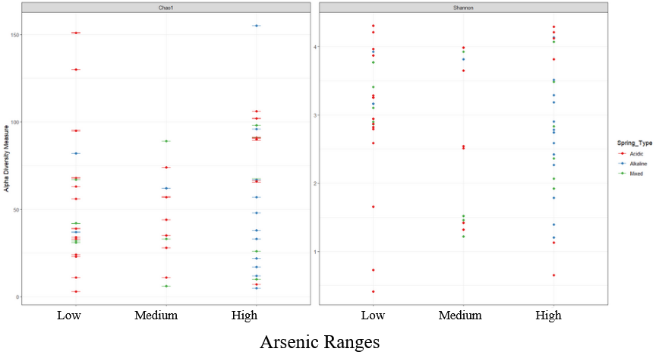
Community Diversity: Arsenic

Slide 8
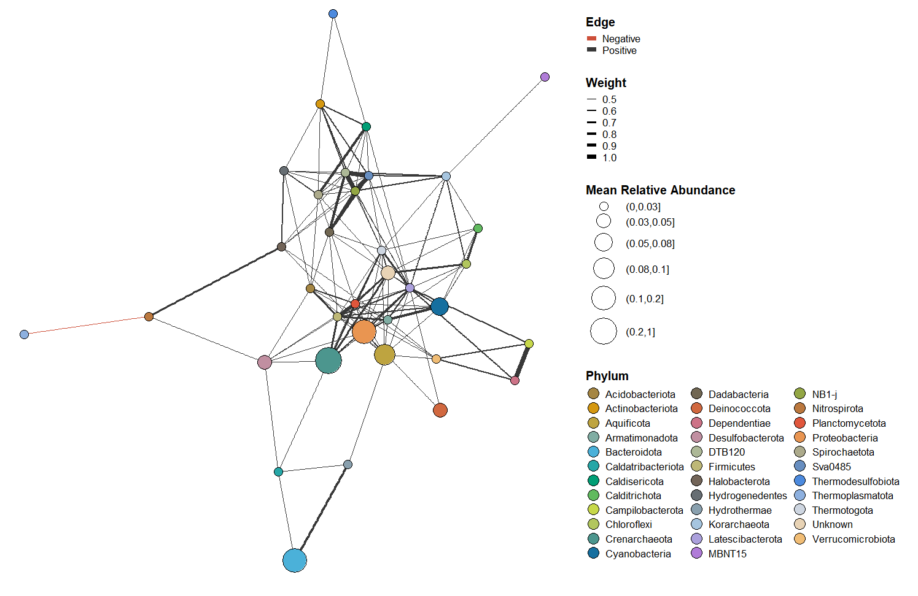
Co-Occurrence Diagrams: Arsenic

Slide 9
Low to High Arsenic: What Changes?
SRB Containing Phyla | Approximate change in relative abundance (from low to high) | DIRB Containing Phyla | Approximate change in relative abundance (from low to high)
Thermodesulfobiota | ~0 | Euryarchaeota (present only in high) | NA
Desulfobacterota | ~0 | Acidobacteriota | +0.03
Thermotogota | ~0 | Actinobacteriota | ~0
Caldisericota | ~0 | Firmicutes | ~0
Calditrichota | ~0 | Proteobacteria | ~0
Crenarchaeota | ~0 | Chloroflexi | ~0

Slide 10
SRB and DIRB correlated pair | Correlation in low arsenic | Correlation in high arsenic | Change in correlation strength
Thermodesulfobiota / Chloroflexi | 0 | 0.570451 | +0.570451
Thermodesulfobiota / Actinobacteria | 0.545801 | 0.502199 | -0.043602
Thermodesulfobiota / Euryarchaeota | 0 | 0.504497 | +0.504497
Desulfobacterota / Crenarchaeota | 0.490065 | 0 | -0.490065
Desulfobacterota / Acidobacteriota | 0.457402 | 0 | -0.457402
Desulfobacterota / Proteobacterota | 0.441984 | 0.42419 | -0.017794
Desulfobacterota / Firmicutes | 0.465858 | 0.632076 | +0.166218
Desulfobacterota / Chloroflexi | 0 | 0.414106 | +0.414106
Thermotogota / Proteobacterota | 0.524923 | 0.391836 | -0.133087
Thermotogota / Firmicutes | 0.507138 | 0.59657 | +0.089432
Caldisericota / Proteobacterota | 0 | 0.432849 | +0.432849
Calditrichota / Chloroflexi | 0.766219 | 0 | -0.766219
Crenarchaeota / Proteobacteria | 0.525495 | 0.467488 | -0.057462
Crenarchaeota / Firmicutes | 0.65708 | 0 | -0.65708
Crenarchaeota / Chloroflexi | 0 | 0.478524 | +0.478524
Totals | 5.381965 | 5.414786 | +0.033366

Slide 11
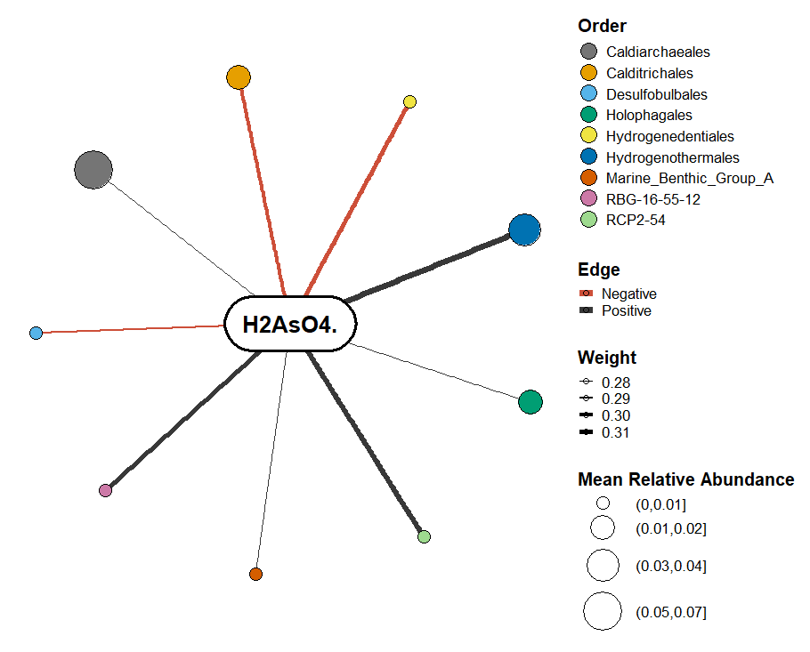
Correlating Arsenic with Taxonomy
Only one SRB present, and negative correlation
Other orders do not have notable known relationship with arsenic

Slide 12
Conclusion
Arsenic does not appear to have significant impact on community composition or diversity, even with species known to have strong relationships with arsenic in other settings. Other metals were also evaluated as part of this study, but were not included in this presentation.

Slide 13
Acknowledgements
Thank you to Kate Weeks, Dr. Everett Shock, Dr. Elizabeth Trembath Reichert, and other members of the GEOPIG research group for your advice and support on this project as well as ASU Space Grant for funding my research and people like Dr. Tom Sharp and Desiree Crawl for supporting me and other interns throughout the year.

Slide 14
Thank you for your attention!

